Slide 1
Information Gathering
System Analysis
Lt Col Nazrul Islam
CSE Dept, MIST
Chapter 05

Slide 2
Objectives
A key part of feasibility analysis is gathering information about the present system. The analyst must know what information to gather, where to find it, how to collect it, and what to make of it.

Slide 3
Objectives
By the end of this chapter, you should know –
What categories or information are available for system analysis.
The sources of information.
Different tools for information gathering.
How to arrange an interview.
The types of interviews and questionnaires.
How to construct a questionnaire.

Slide 4
Introduction
By having crystal clarity of information gathering techniques one can –
Understand the approach and manner in which information is gathered.
Recognize the nature and sources of information.
Perceive a knowledge of what and when to gather and also what channels to use in securing information.
Realize the preparation, experience and training required for the methodology and tools for information gathering.

Slide 5
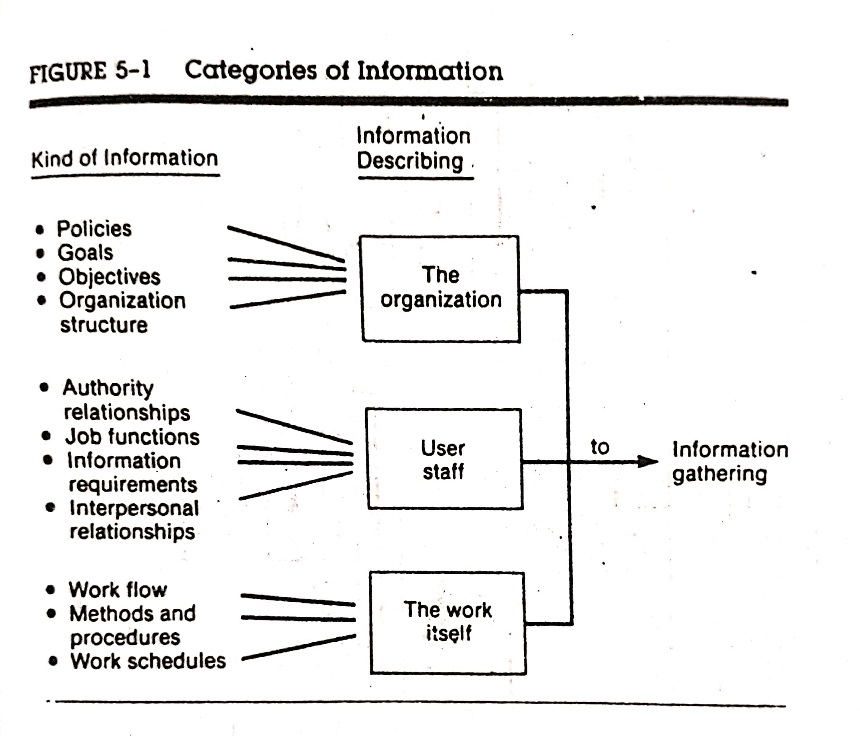
What Kinds of Information Do We Need?
The first requirement is to figure out what information to gather before determining where to go for information or what tools to use.

Slide 6
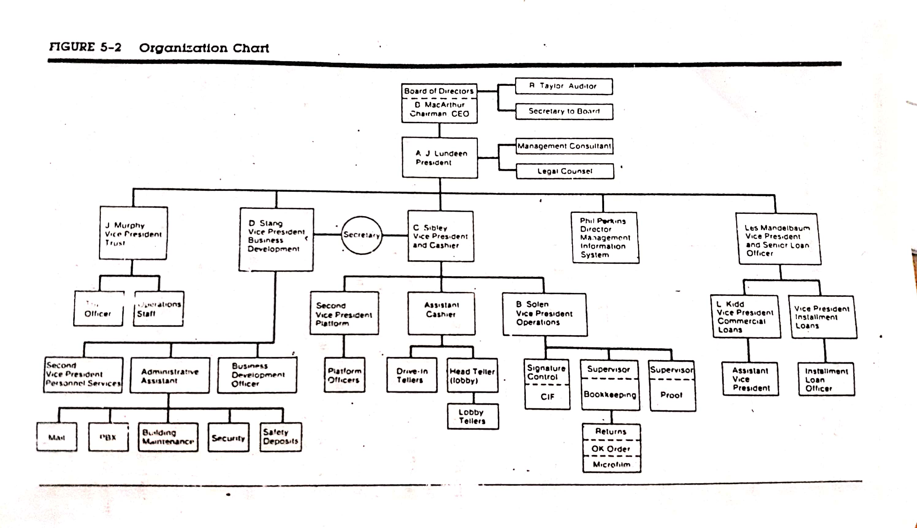
What Kinds of Information Do We Need?

Slide 7
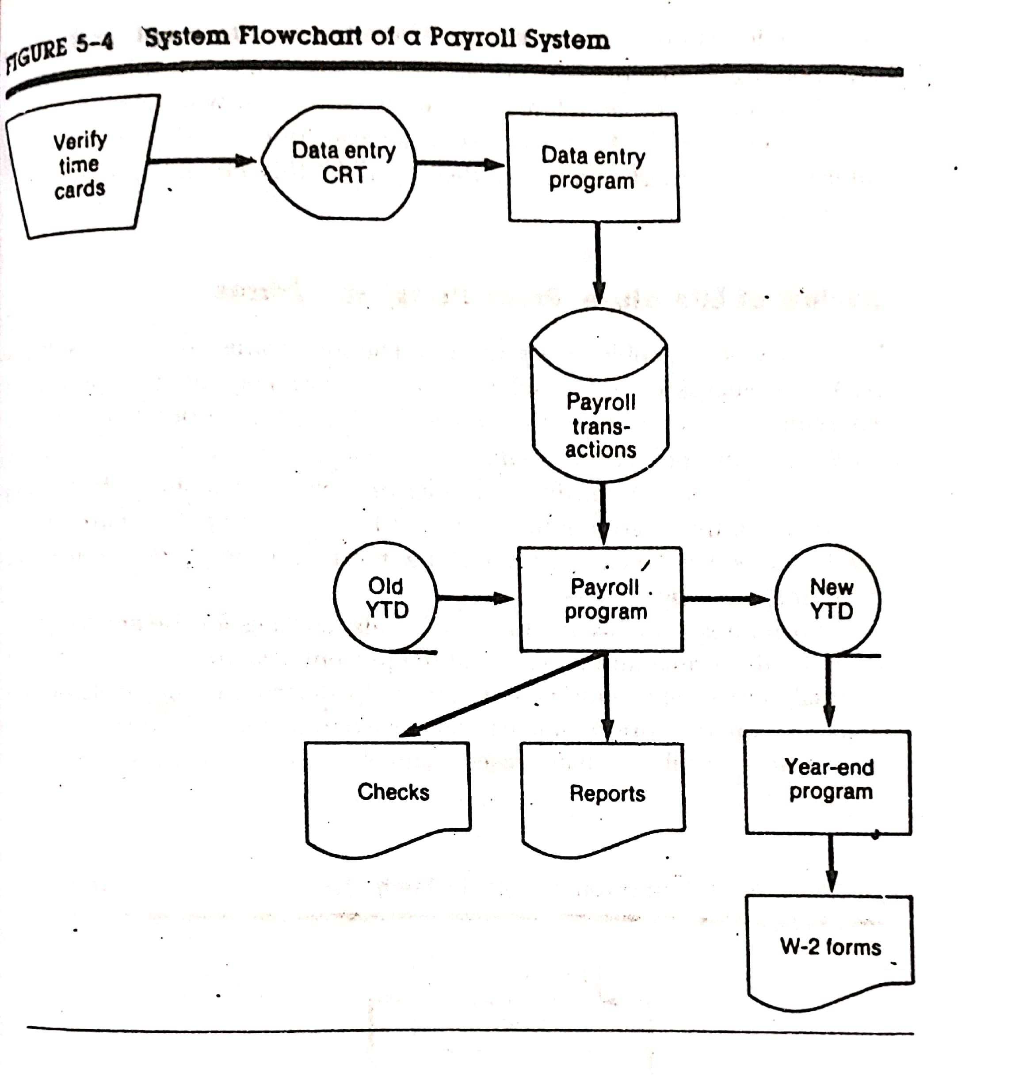
What Kinds of Information Do We Need?
Notes:
Year-to-date payroll – ytd
CRT-Cumulated Result Table

Slide 8
Where does Information Originate?
Information is gathered from two principal sources – personnel or written documents both from within the organization and from the organization’s environment.
The primary external sources are:
Vendors
Government Documents
Newspapers and Professional Journals
The primary internal sources are:
Financial Reports
Personnel Staff
Professional Staff (legal counsel, auditor etc.)
System Documentation or Manuals
The User or User Staff
Reports and Transaction Documents

Slide 9
Information Gathering Tools
There are different types of tools for gathering information from different sources.
The analyst must decide which information gathering tool will be suitable for different context.
Although there are no specific rules for specifying their use, an important rule is that information must be acquired accurately, methodically, under the right conditions and with minimum interruption to user personnel.
For example, if the analyst needs only information available in existing manuals, the interviewing is unnecessary except where the manual is not up to date.

Slide 10
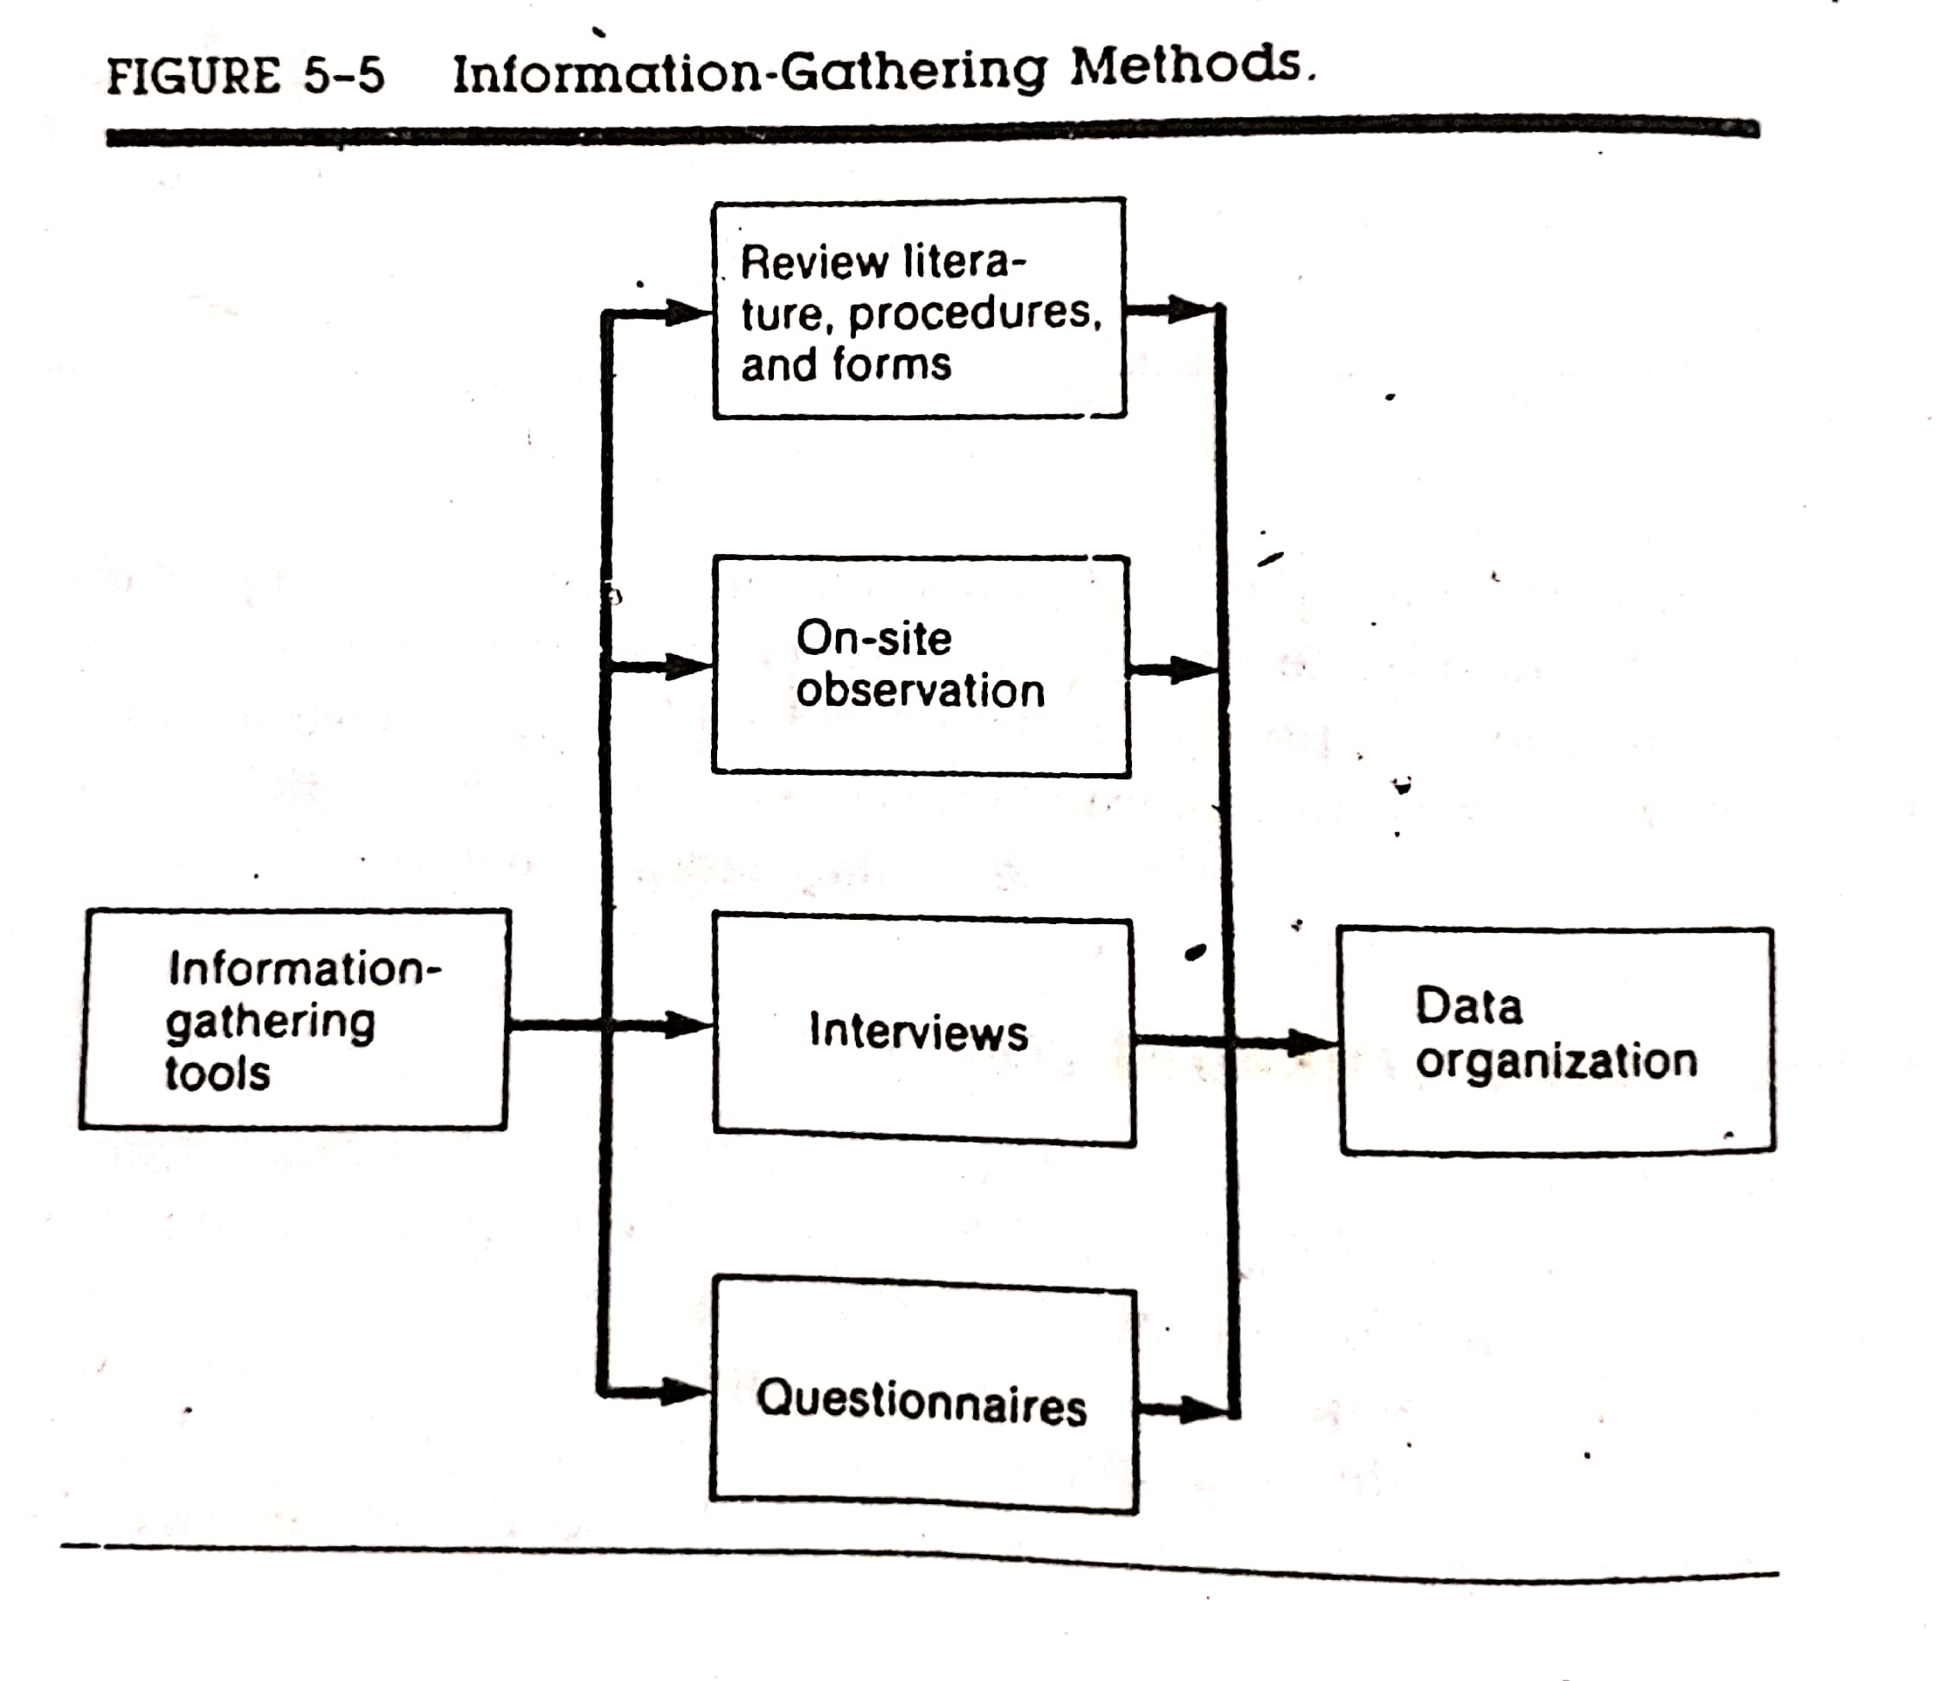
Information Gathering Tools

Slide 11
Review of Literature, Procedures and Forms
A literature review is a comprehensive summary of previous research on a topic, including comparative discussion as well as pros and cons which helps the analyst to provide an overview of what features exists and how they can be enhanced to meet present requirements.
The procedures manuals contain the requirements of the system. This helps in determining to what extent the goals are met by the present system. Day to day problems may have forced changes that are not reflected in the manual.
Regarding existing forms, the analyst needs to find out how they are filled out, how useful they are to the user, what changes need to be made and how easy they are to read.

Slide 12
Review of Literature, Procedures and Forms - Disadvantages
The primary drawback of this search is time.
Sometimes it will be difficult to get certain reports.
Publications may be expensive and the information may be out dated due to a time lag in publication.
Very few system problems are unique. Therefore, a search of the literature through professional references and procedures manuals, textbooks, company studies, government publications or consultant studies may prove invaluable.

Slide 13
On-Site Observation
A fact-finding method used by the systems analyst is on-site or direct observation.
It is the process of recognizing and noting people, objects and occurrences to obtain information.
The major objective of on-site observation is to get as close as possible to the “real” system being studied.
For this reason it is important that the analyst is knowledgeable about the general makeup and activities of the system. The analyst’s role is that of an information seeker. As an observer, the analyst follows a set of rules.

Slide 14
On-Site Observation
As an observer, the analyst follows a set of rules.
While making observations he/she is more likely to listen than talk and has to listen with genuine interest when information is passed on.
The analyst has to observe the physical layout of the current system, the location and movement of the people and the workflow.
The analyst has to be alert to the behavior of the user staff and the people to whom they come into contact. A change in behavior provides a clue to an experienced analyst. The clue can be used to identify the problem.
Giving advice, passing moral judgment, arguing with the persons being observed, showing hostility towards one person and undue friendliness towards another is strictly avoided.

Slide 15
On-Site Observation - Difficulties
On-site observation is the most difficult fact-finding technique.
It requires intrusion into the user’s area and can cause adverse reaction by the user’s staff if not handled properly.
If on-site observation is to be done properly in a complex situation, it can be time-consuming.
Proper sampling procedures must be used to identify the stability of the behavior being observed. Otherwise inferences drawn from these samples will be inaccurate and unreliable.
Attitudes and motivations of subjects cannot be easily observed.

Slide 16
On-Site Observation - Methods
Four alternative observation methods are considered
1) Natural or contrived: A natural observation occurs in a setting such as the employee’s place of work, the observer in a place like a laboratory sets up a contrived observation.
2) Obtrusive or unobtrusive: An obtrusive observation takes place when the respondent knows he/she is being observed; an unobtrusive observation take place in a contrived way such as behind a one-way mirror.
3) Direct or indirect: A direct observation takes place when the analyst actually observes the subject or the system at work. In an indirect observation, the analyst uses mechanical devices such as cameras and videotapes to capture information.
4) Structured or unstructured: In a structured observation, the observer looks for and records a specific action. Unstructured methods place the observer in a situation to observe whatever might be pertinent at the time.

Slide 17
Interviews and Questionnaires
On-site observation is less effective for learning about people’s perceptions, feelings and motivations. The alternative is the personal interview and the questionnaire.
In both the methods heavy reliance is placed on the interviewees report for information about the job, the present system, or experience. The quality of the response is judged in terms of its reliability and validity.
Reliability means that the information gathered is dependable enough to be used for making decisions about the system being studied. Validity means that the questions to be asked are worded in such a way as to elicit (obtain) the intended information.
In an interview, since the analyst (interviewer) and the person interviewed meet face to face, there is an opportunity for flexibility in collecting information. The analyst is also in a position to observe the subject. In contrast, the information obtained through a questionnaire is limited to the subject’s written responses to predefined questions.

Slide 18
Interviews (Pros and Cons)
The advantages of interview are –
1) Its flexibility makes the interview a superior technique for exploring areas where not much is known about what questions to ask or how to formulate questions.
2) It offers a better opportunity than the questionnaire to evaluate the validity of the information gathered. The interviewer can observe not only what subjects say but also how they say it.
3) It is an effective technique for eliciting information about complex subjects and for probing the sentiments underlying expressed opinions
4) Many people enjoy being interviewed, regardless of the subject. They usually cooperate in a study when all they have to do is talk. In contrast the percentage of returns to a questionnaire is relatively low.
The disadvantages of an interview are –
1) The major drawback of the interview is the long preparation time.
2) Interview also take a lot of time to conduct, which means time and money.

Slide 19
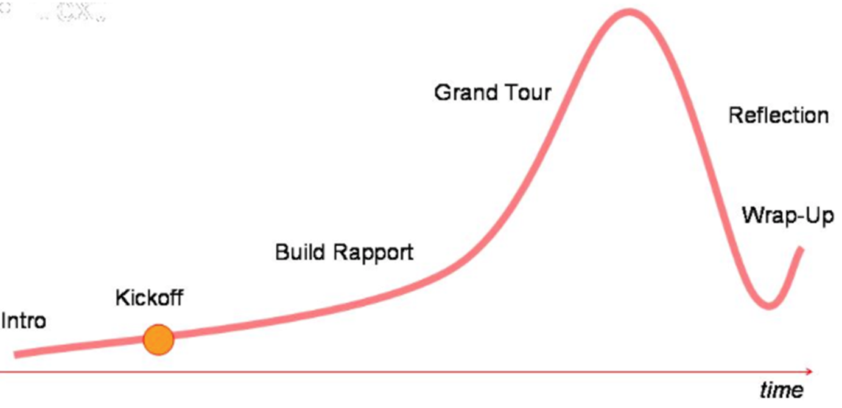
Guides to a Successful Interview
In an interview the following steps should be taken –
1) Set the stage for the interview: create a friendly atmosphere.
2) Establish rapport: put the interviewee at ease.
3) Phrase questions clearly and succinctly
4) Be a good listener; avoid arguments.
5) Evaluate the outcome of the interview.

Slide 20
Guides to a Successful Interview
Introduction
“Hi, I’m a student studying wellbeing of people. I’m interested in hearing about your daily life and activities. There are no right or wrong answers, I just want to hear what you have to say.”
Kick-off
“How do you feel today?”
Build rapport
“What did you do today before coming here? How was it? Do you have a favorite daily activity?”
Grand Tour
“Can you describe your most memorable activity experience? Why was it so unique? What happened?”
Reflection
“If you were designing the ultimate device to support your daily activity based on your ideal experience. . .”

Slide 21
Questionnaires (Pros and Cons)
This tool has collection of questions to which individuals respond. The advantages of questionnaire are
1. It is economical and requires less skill to administer than the interview.
2. Unlike the interview, which generally questions one subject at a time, a questionnaire can be administered to large numbers of individuals simultaneously.
3. The standardized wording and order of the questions and the standardized instructions for reporting responses ensure uniformity of questions.
4. The respondents feel greater confidence in the anonymity of a questionnaire than in that of an interview. In an interview, the analyst usually knows the user staff by name, job function or other identification. With a questionnaire, respondents give opinions without fear that the answer will be connected to their names.
5. The questionnaire places less pressure on subjects for immediate responses. Respondents have time to think the questions over and do calculations to provide more accurate data.
6. The information obtained through a questionnaire is limited to the subject’s written responses to predefined questions.

Slide 22
Types of Interviews and Questionnaires
Interviews range from highly unstructured to the highly structured alternative in which the questions and responses are fixed.
The Unstructured Alternative:
This is a non-directive information gathering technique. It allows respondents to answer questions freely in their own words. The responses in this case are spontaneous and self-revealing. This method works well in a permissive atmosphere in which subjects have no feeling of disapproval.
The Structured Alternative:
In this alternative the questions are presented with exactly the same wordings and in the same order to all subjects. Standardized questions improve the reliability of the responses by ensuring that all subjects are responding to the same questions. Questions may be structured as either closed or open-ended.
An open-ended question requires no response direction or specific response.
Closed questions are those, in which the responses are presented as a set of alternatives.

Slide 23
Types of Interviews and Questionnaires
Interviews range from highly unstructured to the highly structured alternative in which the questions and responses are fixed.
The Unstructured Alternative:
This is a non-directive information gathering technique. It allows respondents to answer questions freely in their own words. The responses in this case are spontaneous and self-revealing. This method works well in a permissive atmosphere in which subjects have no feeling of disapproval.
The Structured Alternative:
In this alternative the questions are presented with exactly the same wordings and in the same order to all subjects. Standardized questions improve the reliability of the responses by ensuring that all subjects are responding to the same questions. Questions may be structured as either closed or open-ended.
An open-ended question requires no response direction or specific response.
Closed questions are those, in which the responses are presented as a set of alternatives.

Slide 24
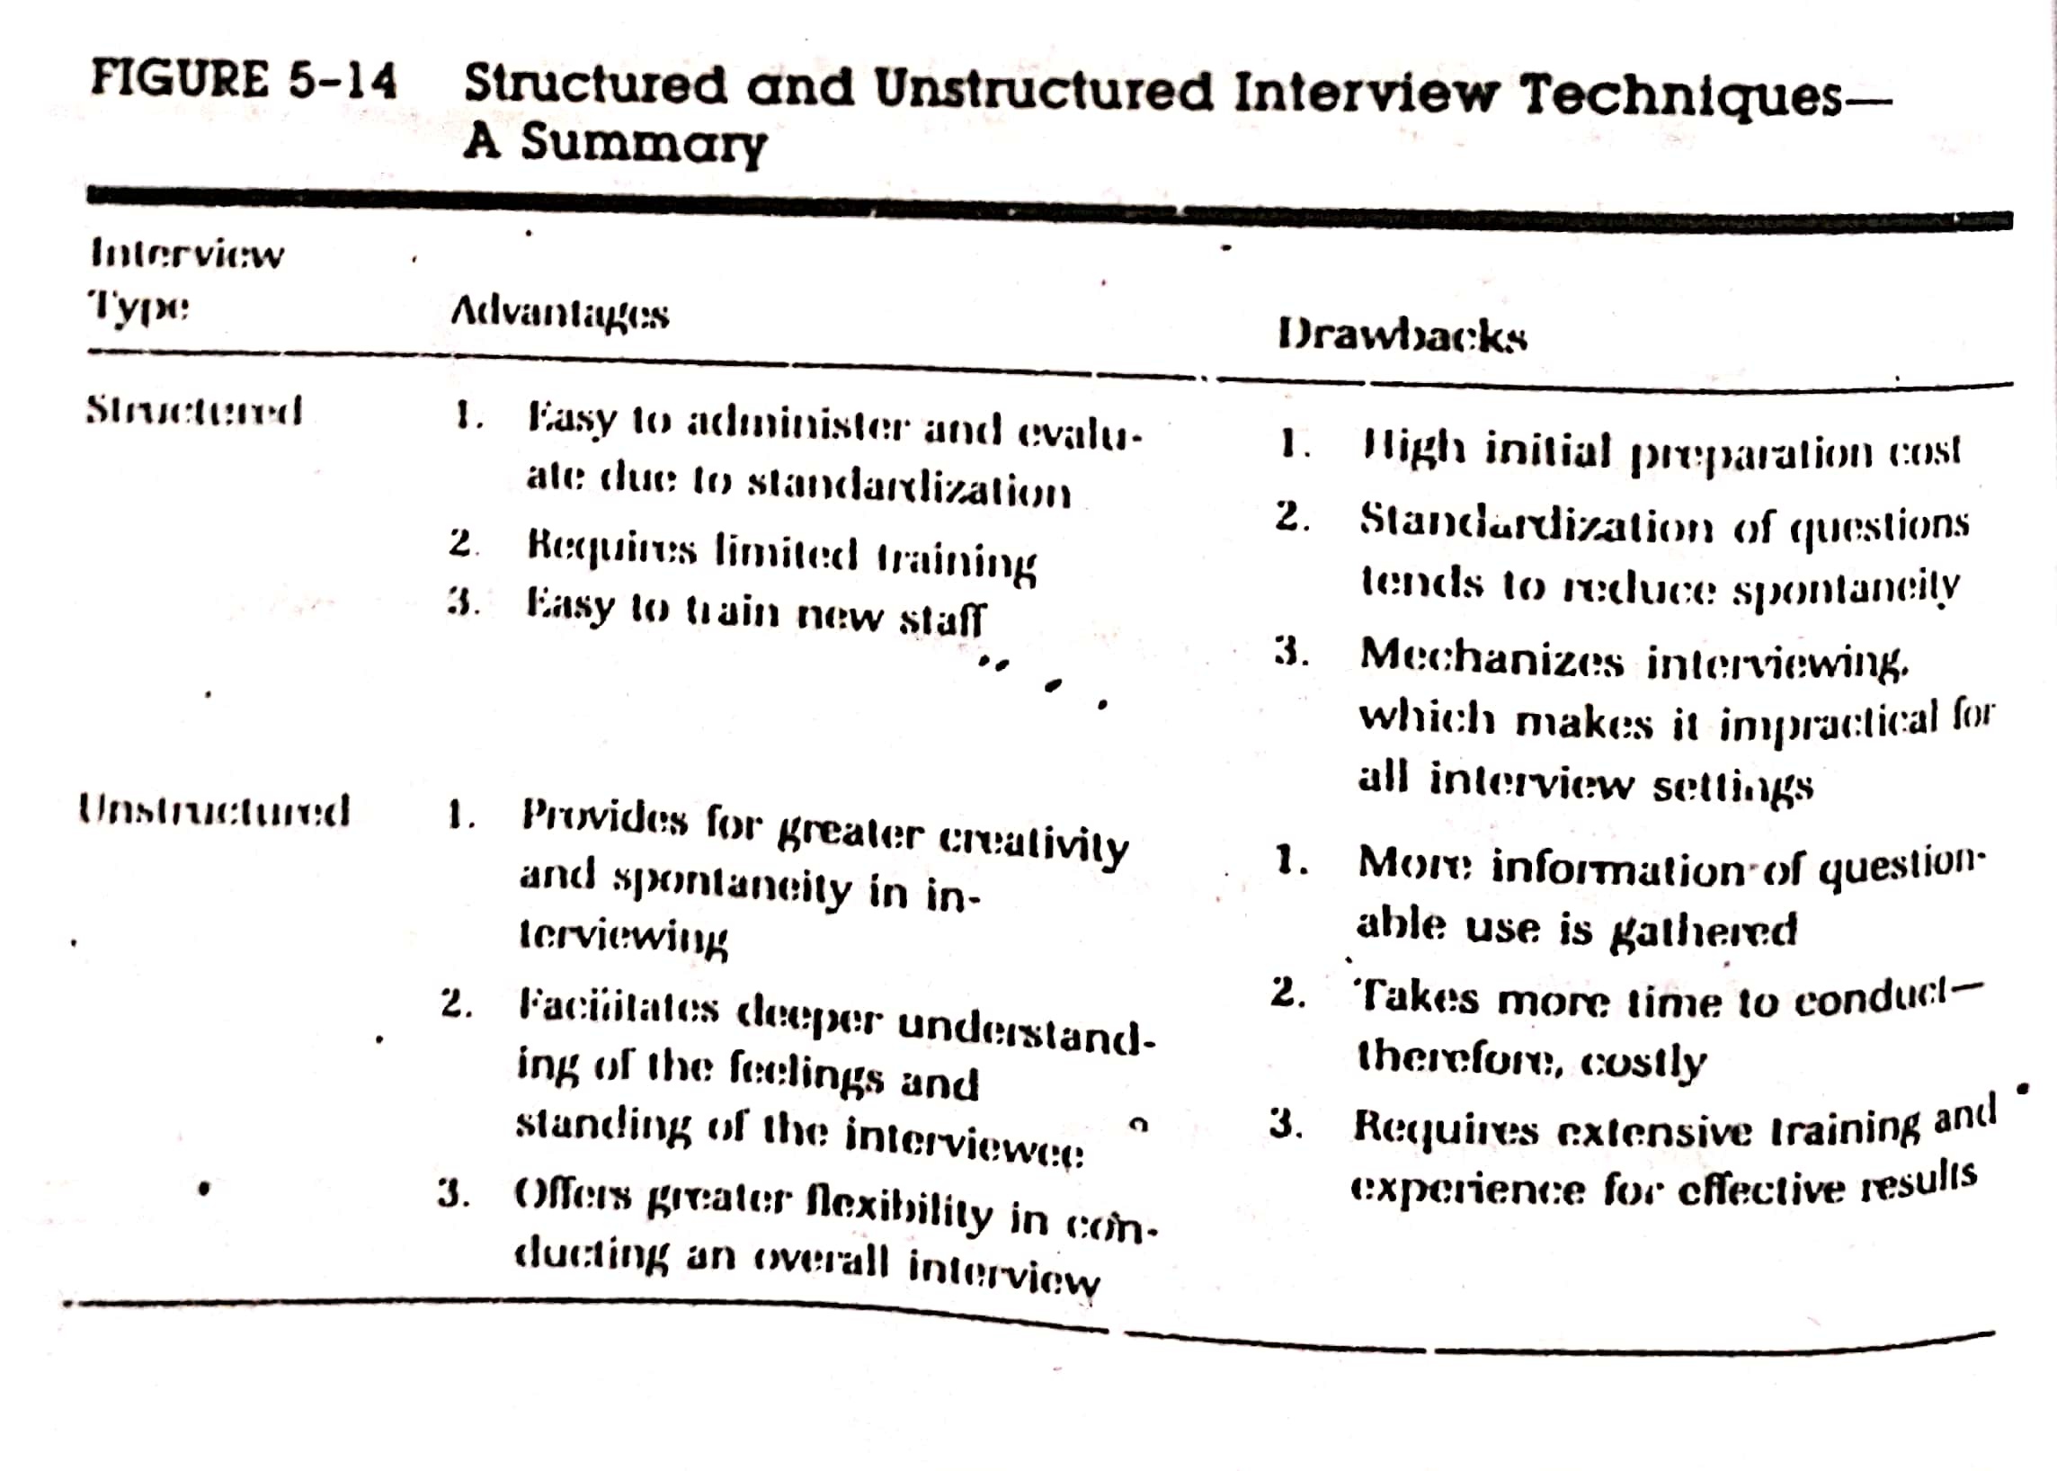
Types of Interviews and Questionnaires

Slide 25
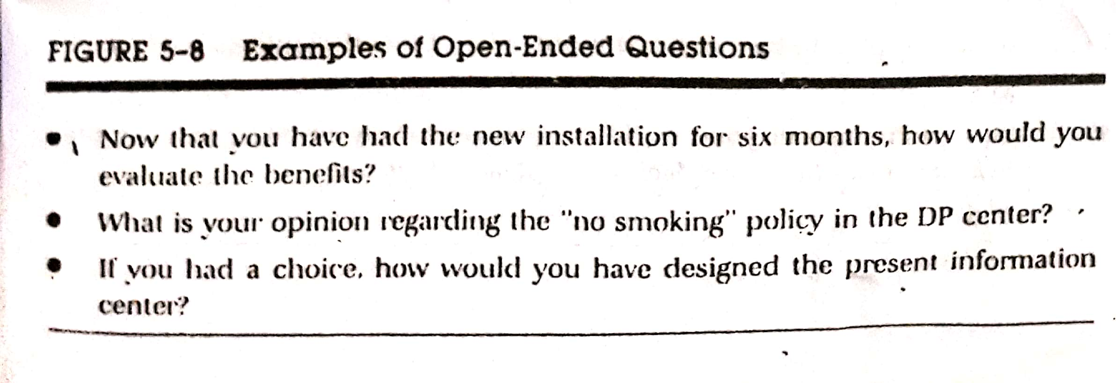
Different Types of Questions (Examples)

Slide 26
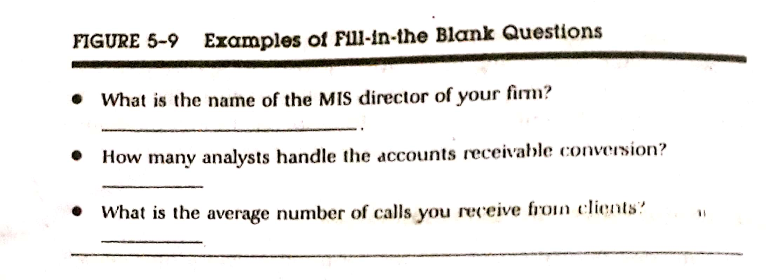
Different Types of Questions (Examples)

Slide 27
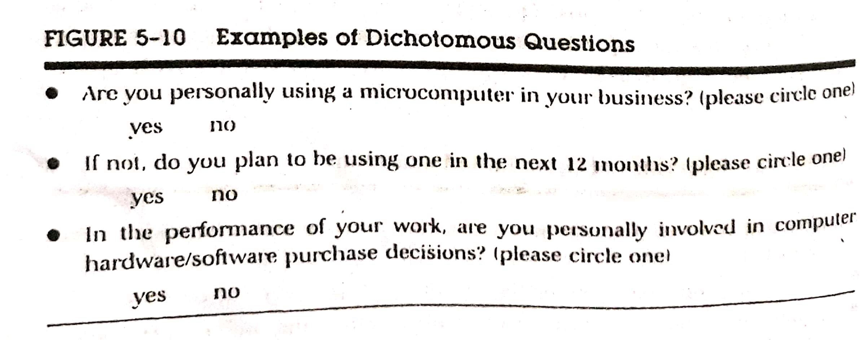
Different Types of Questions (Examples)

Slide 28
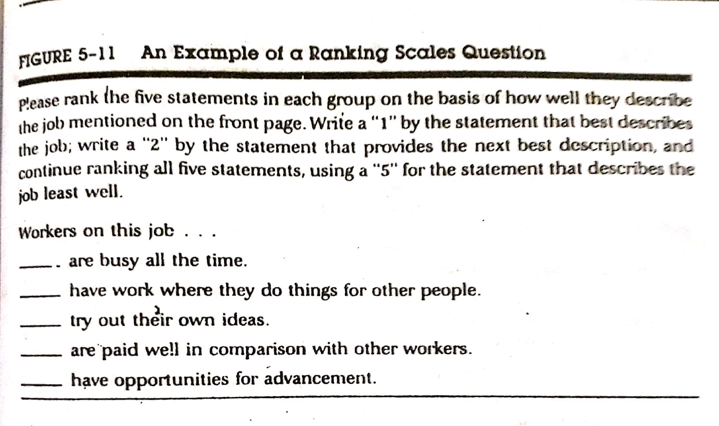
Different Types of Questions (Examples)

Slide 29
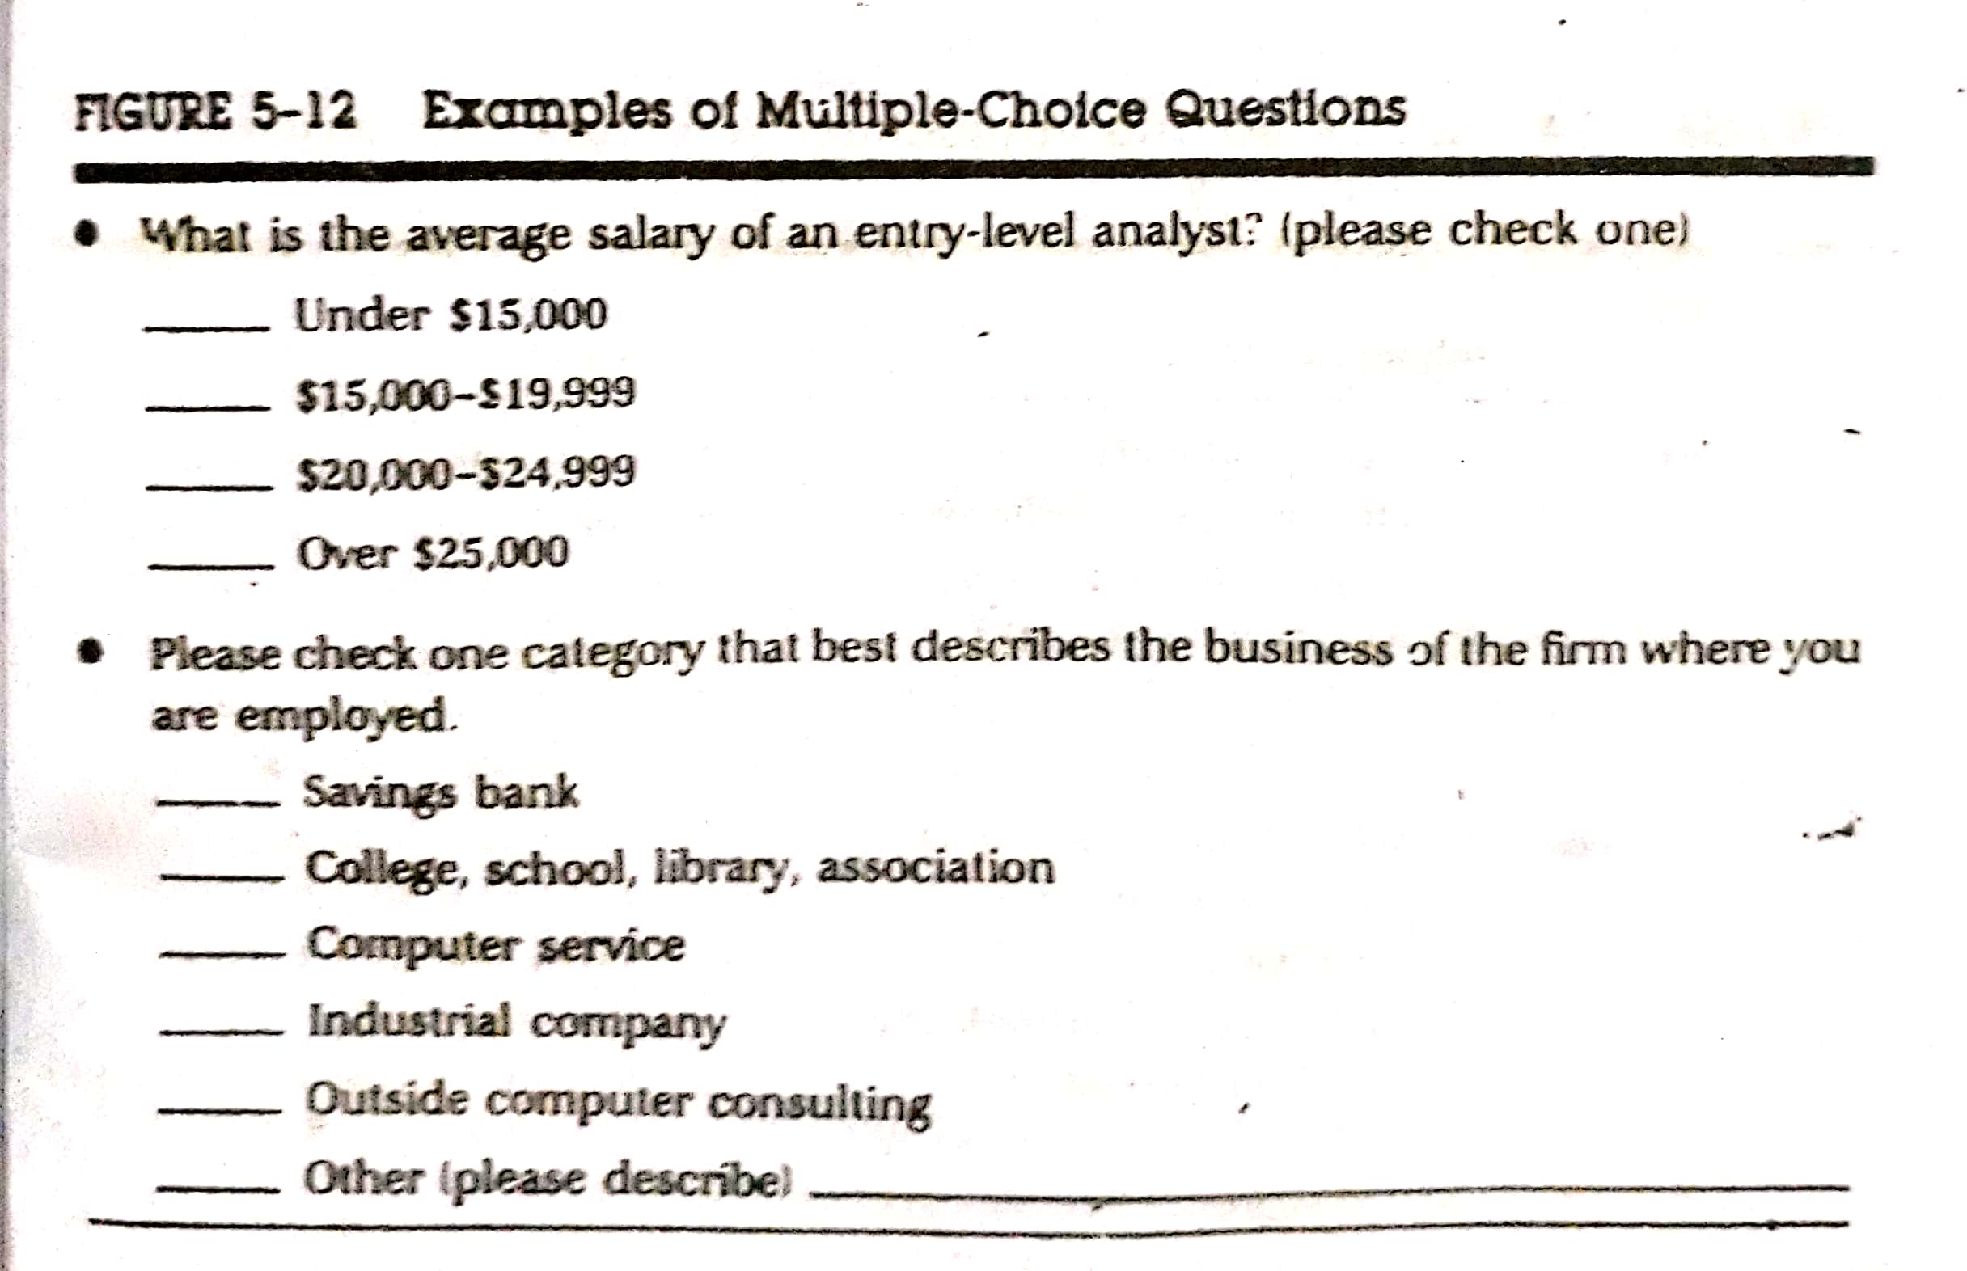
Different Types of Questions (Examples)

Slide 30
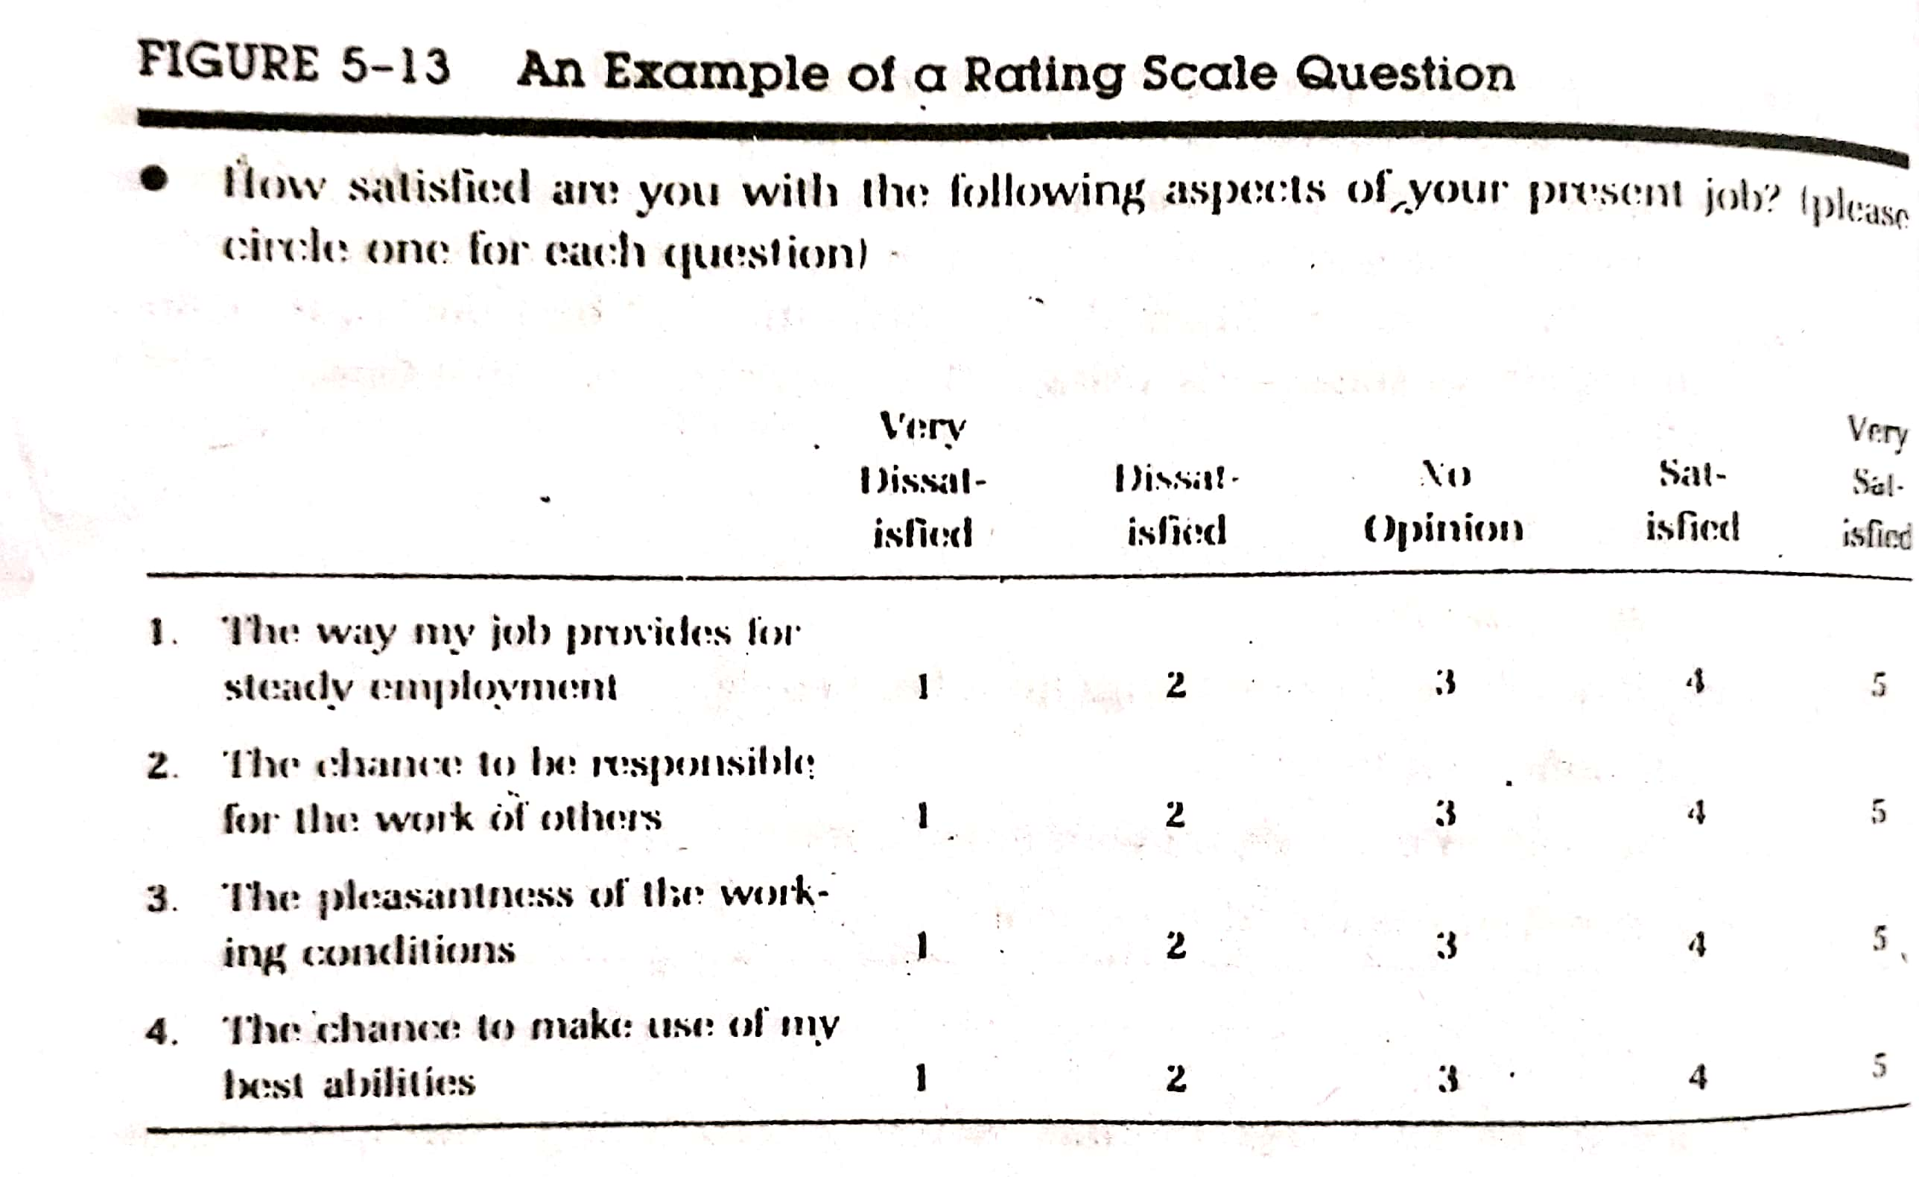
Different Types of Questions (Examples)

Slide 31
Procedure for Questionnaire Construction
There are six steps for constructing a questionnaire –
Decide on the data should be collected, that is used to define the problem to be investigated.
Decide the type of questionnaire should be used (closed or open ended).
Outline the topics for the questionnaire and then write the questions.
Edit the questionnaire for technical defect that reflect personal values.
Pretest the questionnaire to see how well it works.
Do a final editing to ensure that questionnaire is ready for administration. This includes a close look at the content, form and sequence of questions as well as the appearance and clarity of the procedure for using the questionnaire.

Slide 32
Reliability-Validity Issue
Information – gathering instrument faces 2 major tests – reliability and validity.
The term reliability is synonymous with dependability, consistency and accuracy. Concern for reliability comes from the necessity for dependability in measurement. Reliability may be approached in 3 ways –
If we administer the same questionnaire to the same subject will we get the similar or same results? This question implies a definition of reliability as stability, dependability and predictability.
Does the questionnaire measure the true variables? This question focus on the accuracy aspect of reliability.
How much error of measurement is there in the proposed questionnaire? Errors of measurement are random errors.

Slide 33
Reliability-Validity Issue
The most common question that defines validity is:
Does the instrument measure what we think it is measuring?
It refers to the notion that the questions asked are worded to produce the information sought.
In contrast reliability means that information gathered is dependable enough to be used for decision making.
In validity, the emphasis is on what is being measured?
Thus the adequacy of an information-gathering tool is judged by the criteria of validity and reliability. Both depend on the design of the instrument as well as the way it is administered.

Slide 34
THANK YOU

